Slide 1
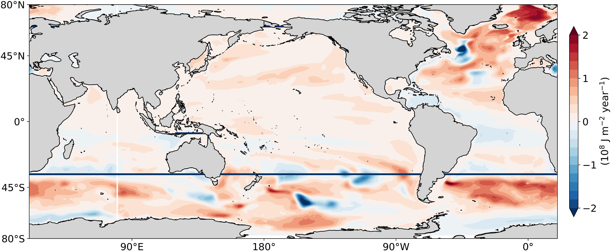
[319.2, 312.3, 34.6]
Full forcing: 7.0
Wind-only: 4.1
-1.9
-1.0
Thermal-only: 3.2
-0.9
0.7
0.8
0.2
-0.3
-0.5
0.2
0.9
1.0
1.0
1.0
1.0
1.5
1.1
0.3
0.4
0.3
1.3
3.0
Heat loss
Heat transport
10²¹ J year⁻¹
Heat uptake

Slide 2
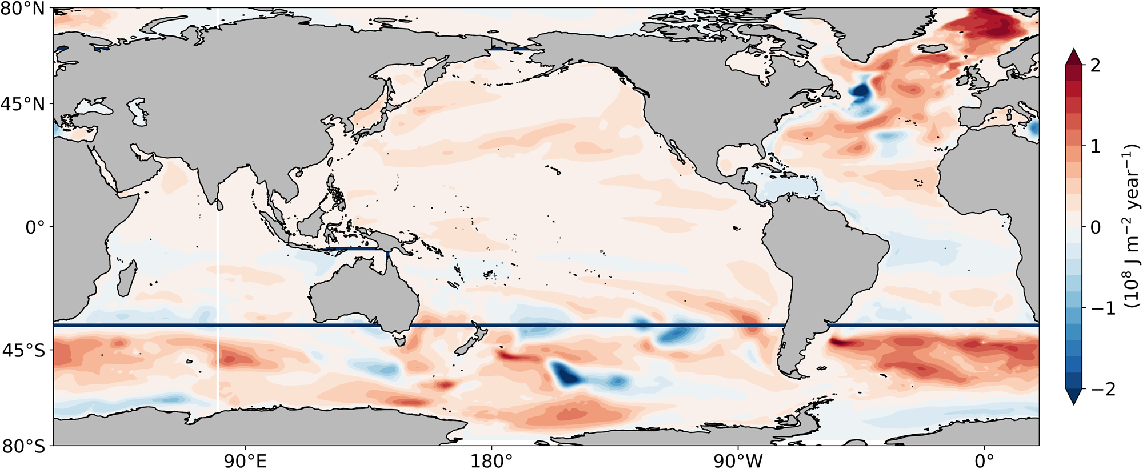
Full forcing: 7.0
0.7
Wind-only: 4.1
0.2
0.8
Thermal-only: 3.2
0.9
1.0
0.3
0.4
1.0
-0.3
0.3
-0.5
0.2
-1.9
-1.0
10²¹ J year⁻¹
-0.9
1.3
1.0
Heat uptake
1.0
Heat loss
3.0
1.5
1.1
Heat transport

Slide 3
Full forcing: 7.0
Wind-only: 4.1
0.7
0.8
0.2
Thermal-only: 3.2
0.3
0.9
1.0
0.4
0.3
1.0
-0.3
-0.5
0.2
-1.9
-1.0
10²¹ J year⁻¹
-0.9
1.3
1.0
Heat uptake
1.0
Heat loss
3.0
1.5
1.1
Heat transport

Slide 4
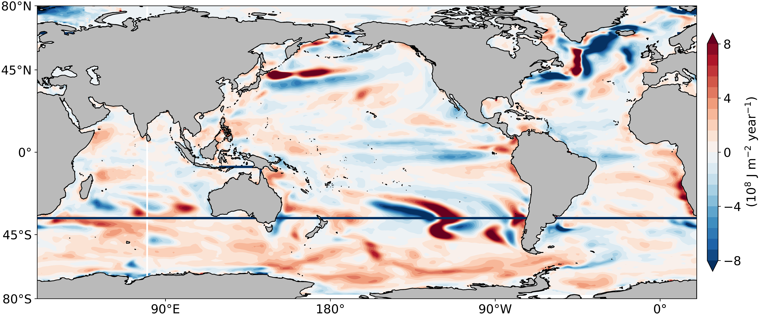
Full forcing: 7.0
0.7
Wind-only: 4.1
0.8
0.2
Thermal-only: 3.2
-0.3
0.3
0.9
1.0
-0.5
0.4
0.3
1.0
0.2
10²¹ J year⁻¹
-1.9
-1.0
-0.9
1.3
1.0
1.0
3.0
1.5
1.1

Slide 5
New Figure 20211207

Slide 6
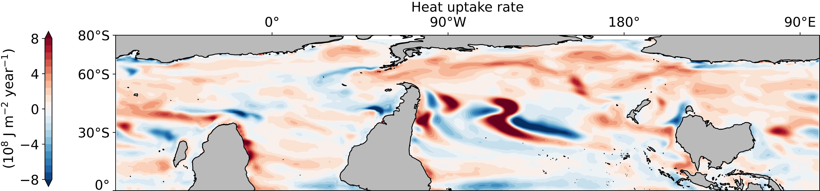
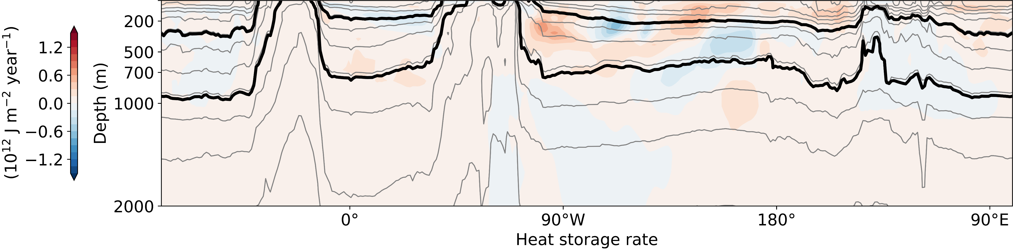
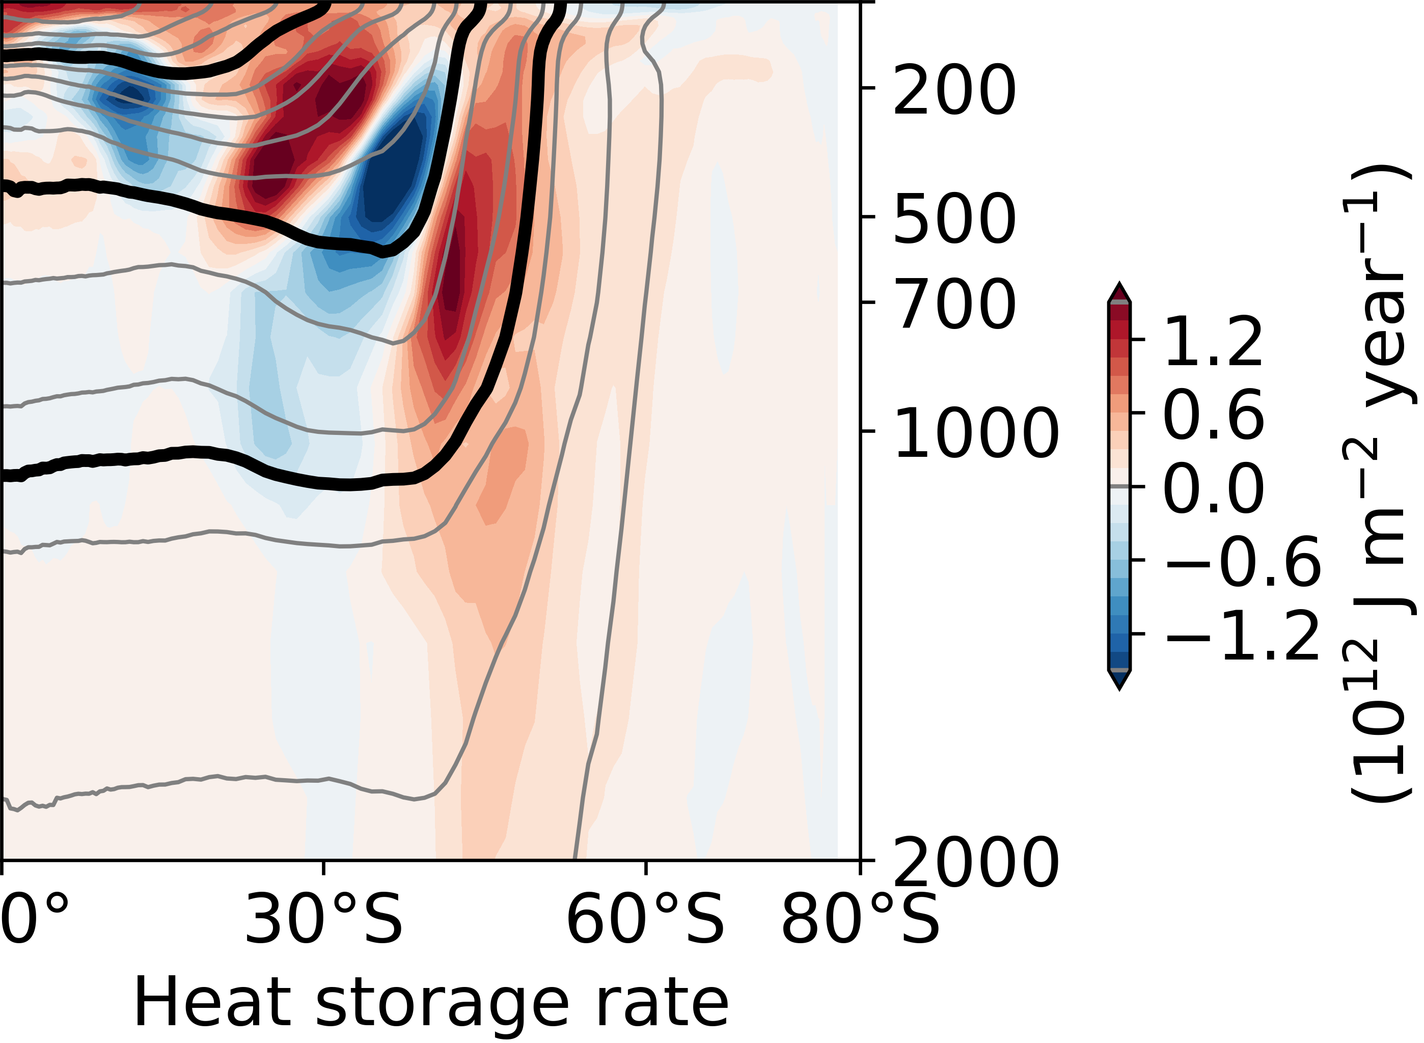
Schematic_OHC_map_and_side_panels.ipynb
work in progress
Increased westerlies
Heat uptake
Heat uptake
Increased westerlies
10°C
Heat loss
5°C
Transport along
isopycnals
20°C
transport along
isopycnals
10°C
5°C

Slide 7
Full global figure

Slide 8
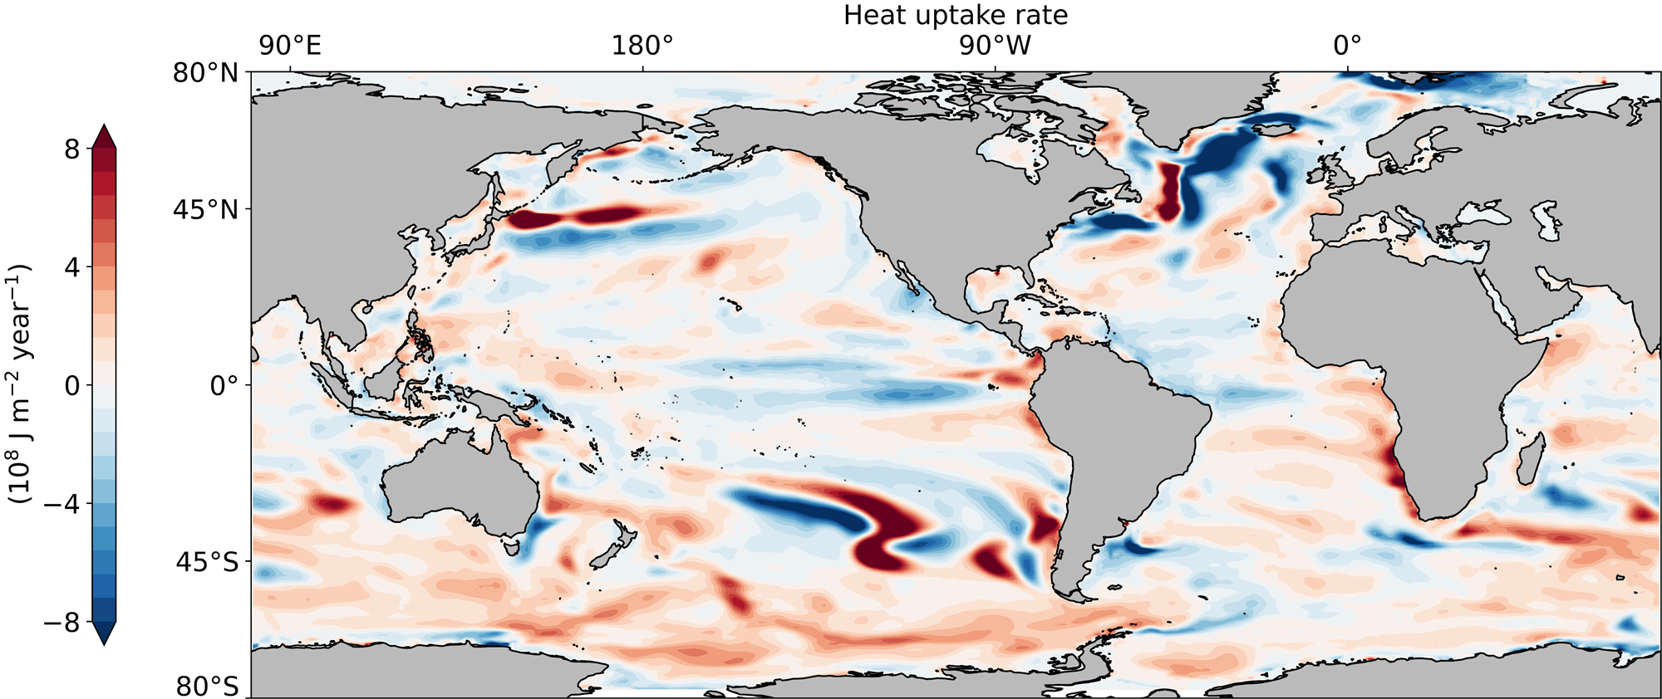
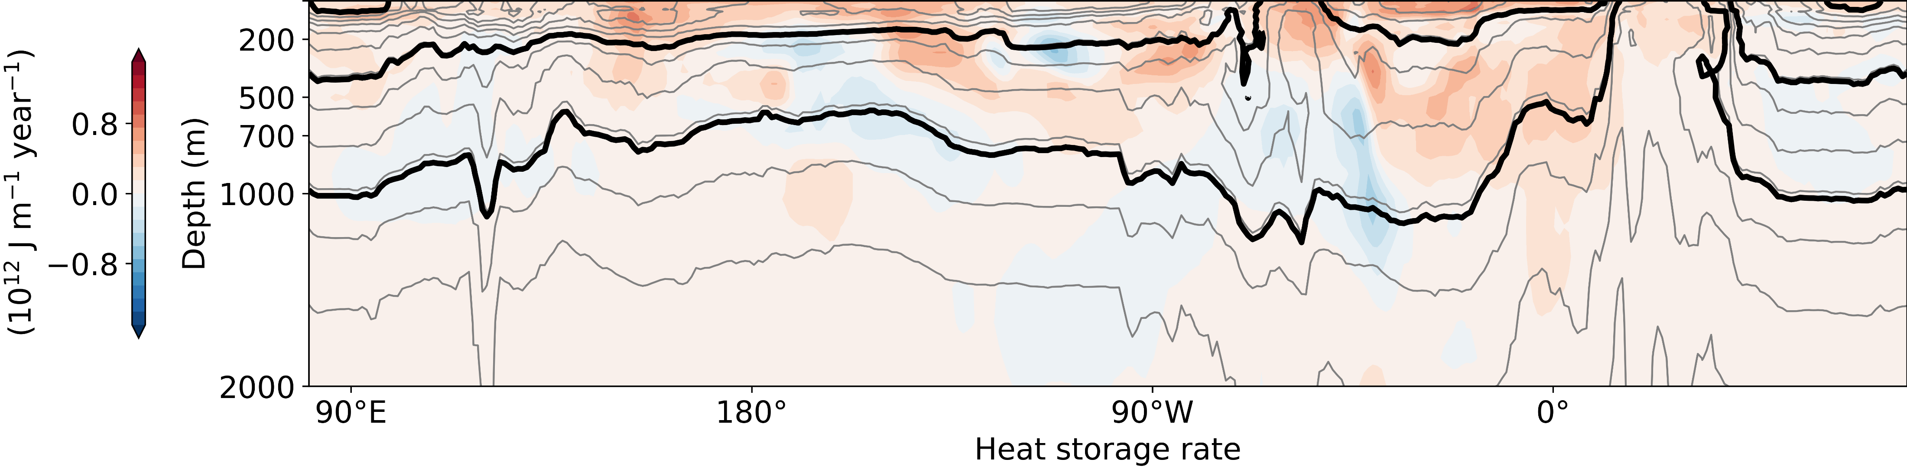
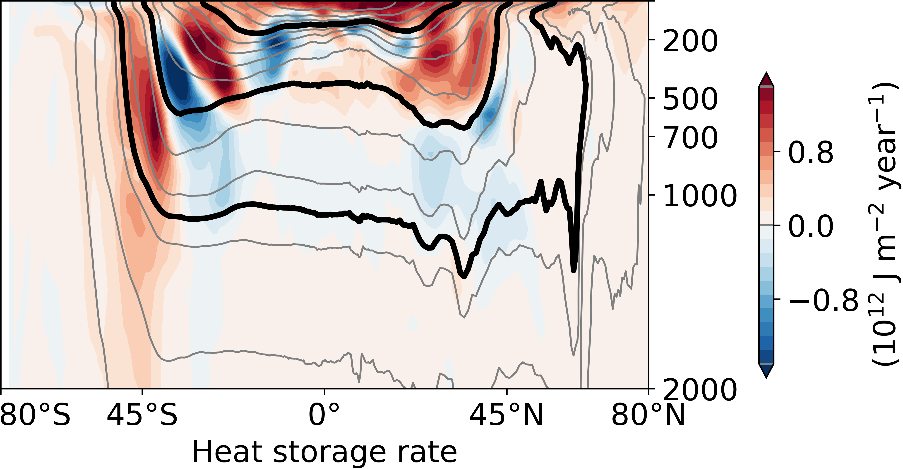
work in progress

Slide 9

regional_spatial_maps_and_zonal_integral_of_accumulated_ocean_heat_content_and_net_sfc_heating_anomalies-PI_Offset.ipynb
work in progress

Slide 10
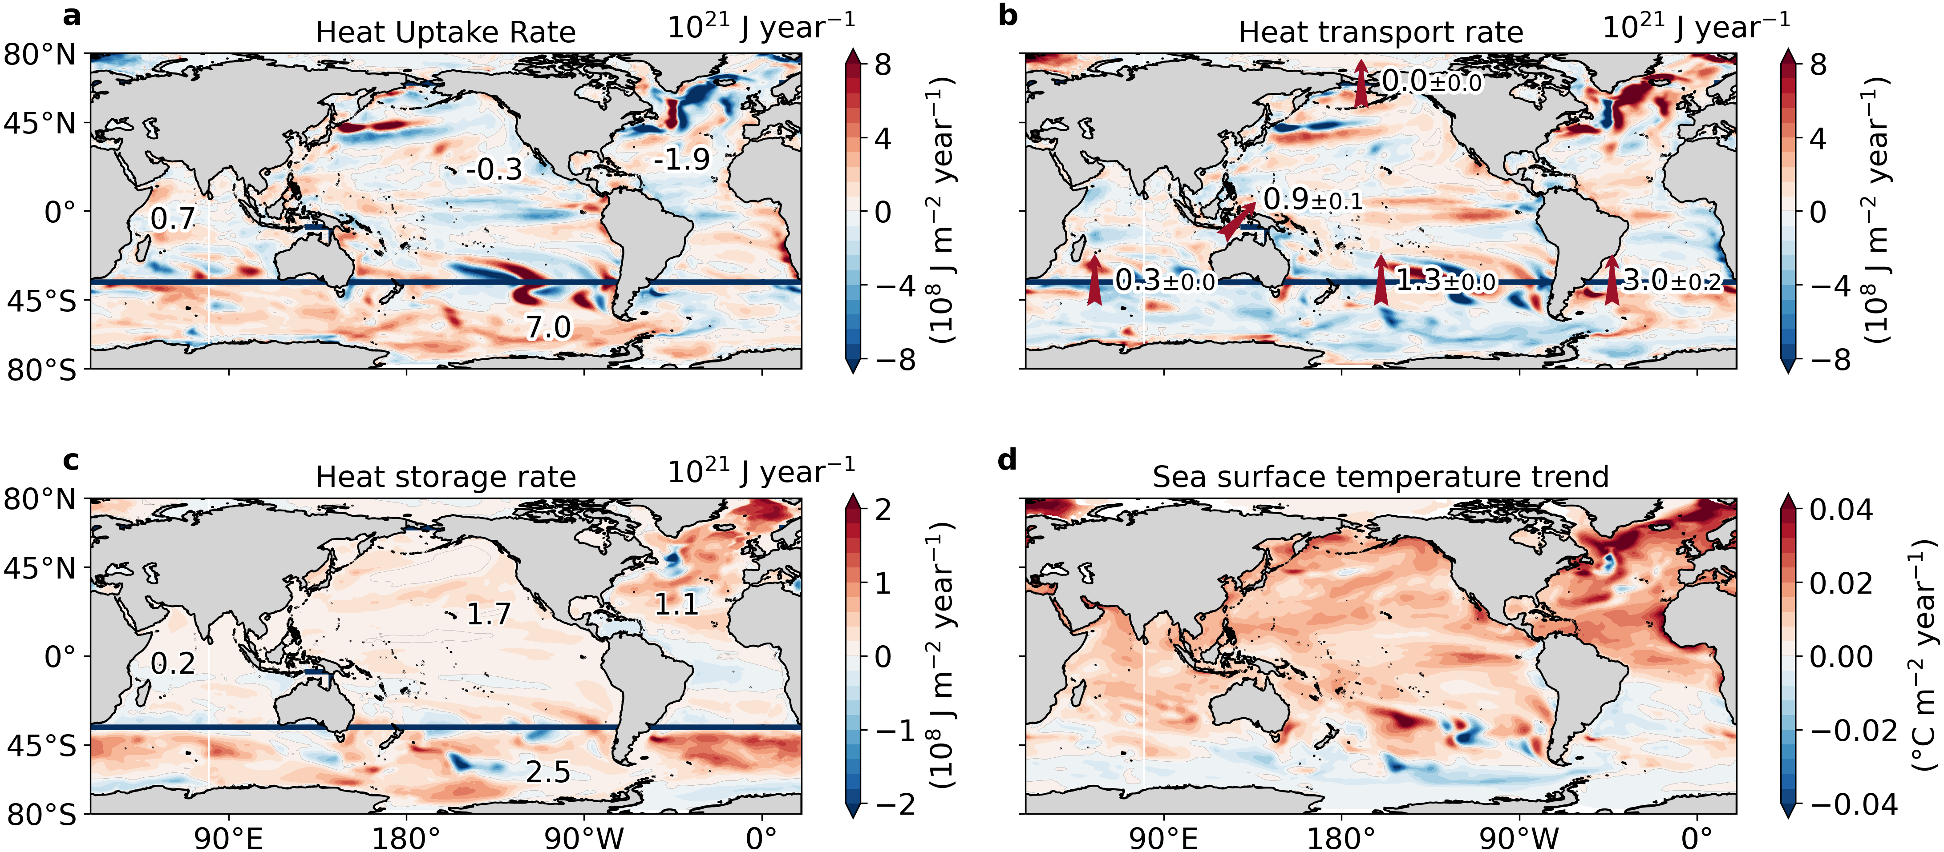

Slide 11
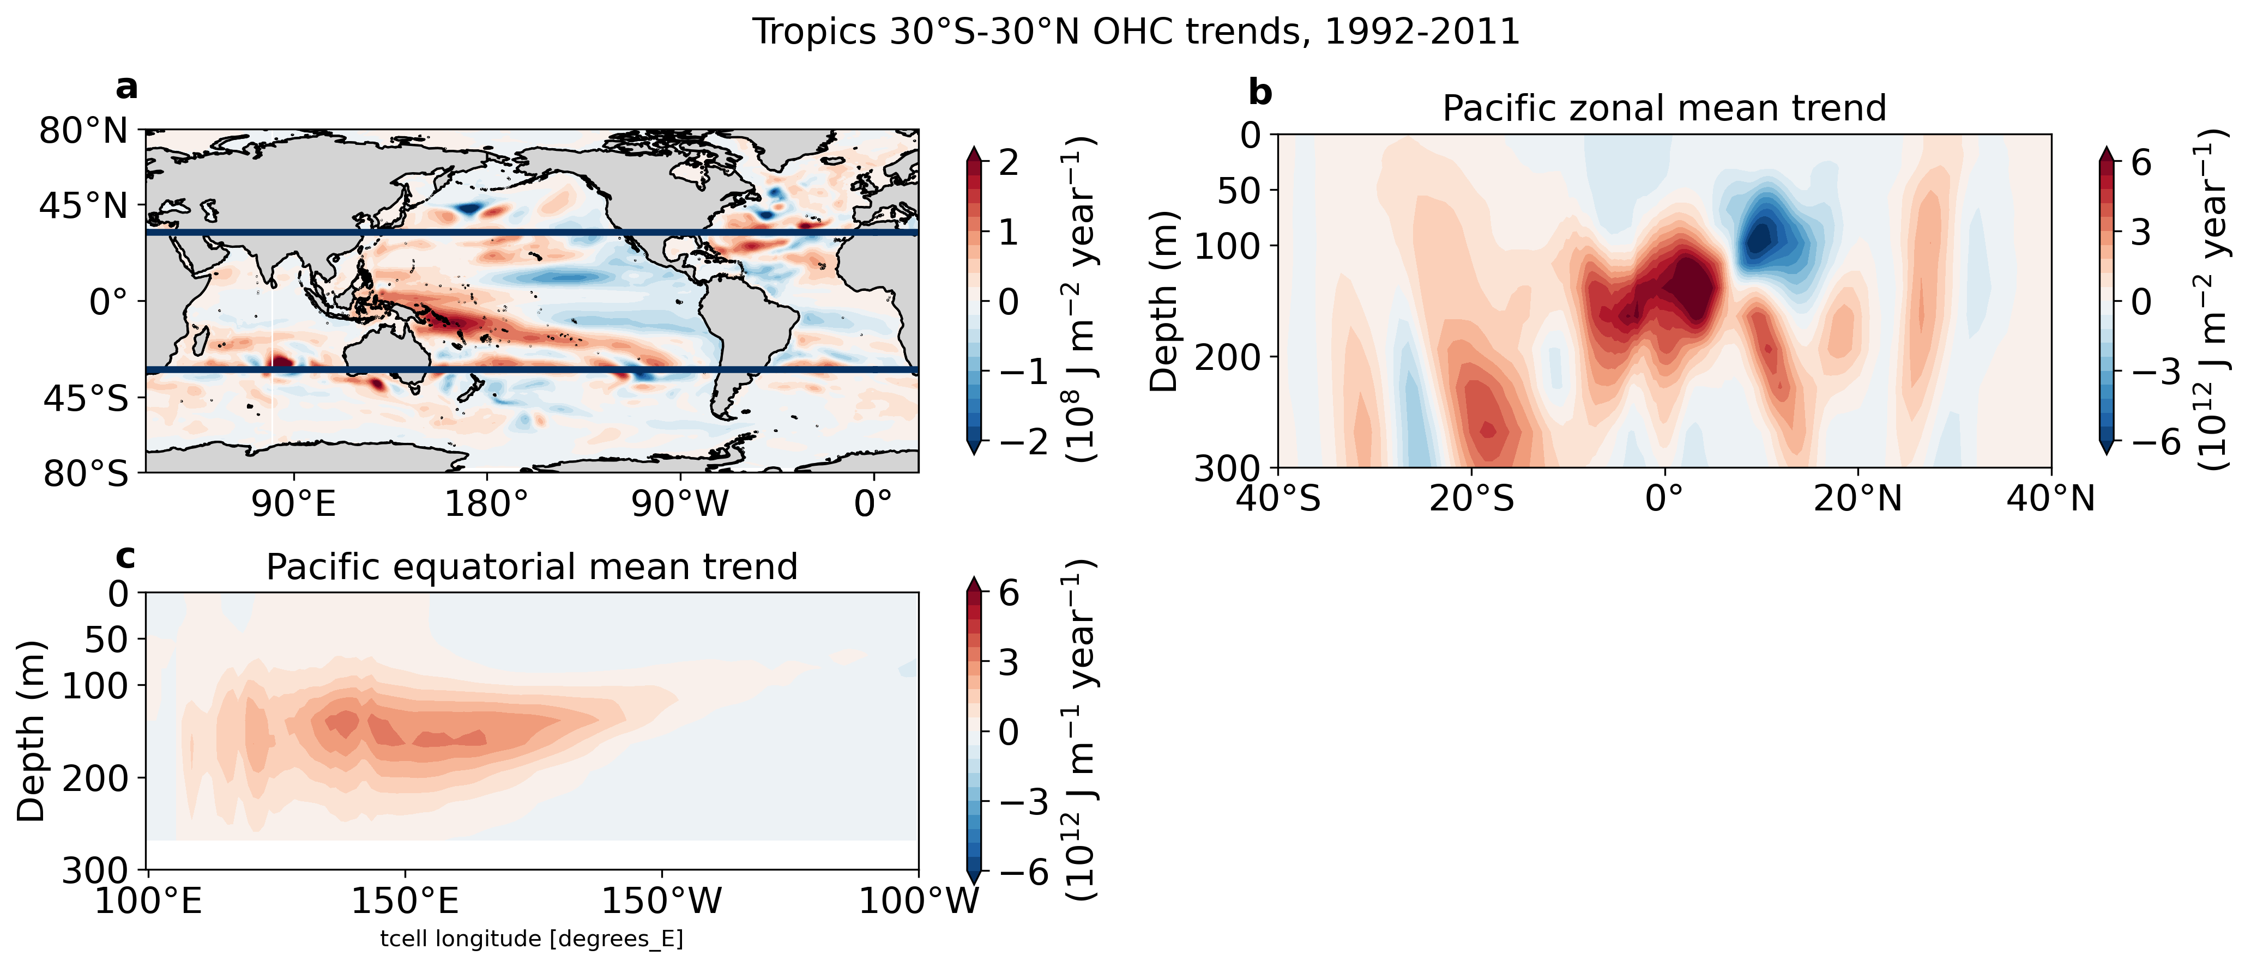

60°E
120°E
Heat uptake rate
120°W
60°W
0
100
300
5000
5000 m
Heat storage rate
Heat storage rate

Slide 12
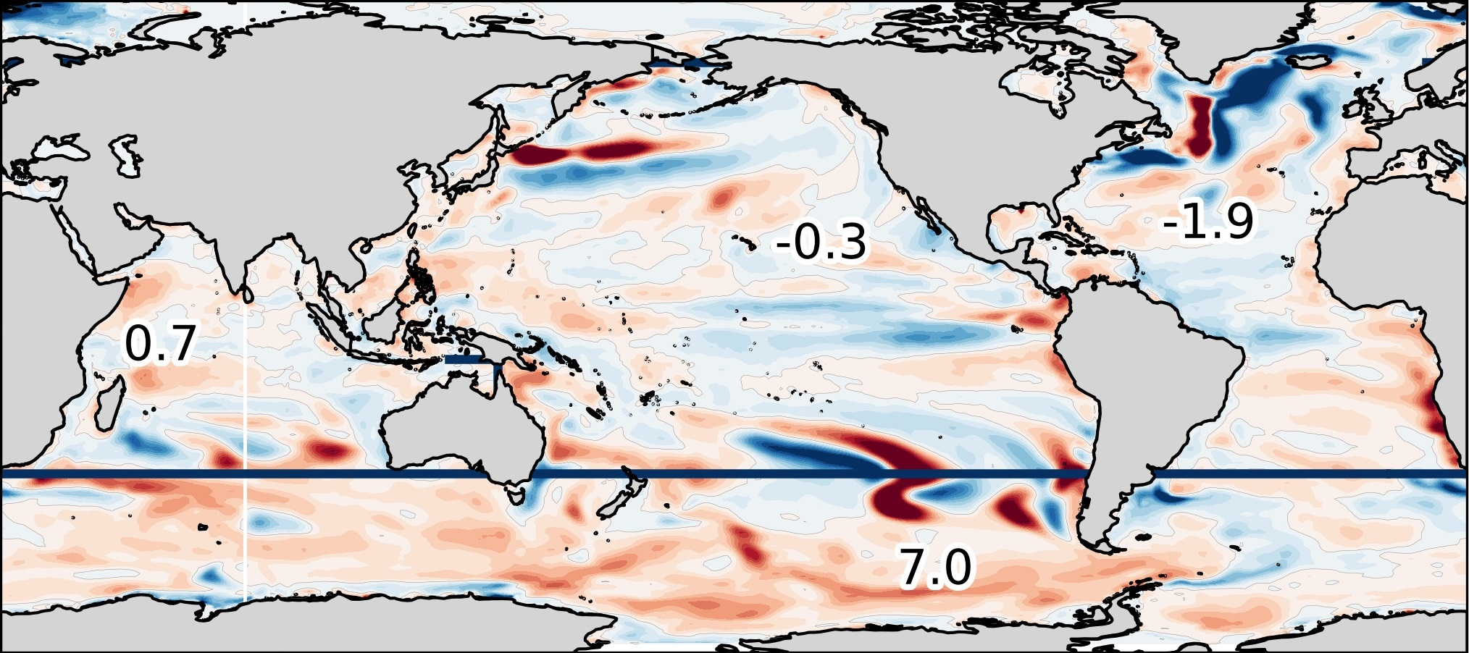
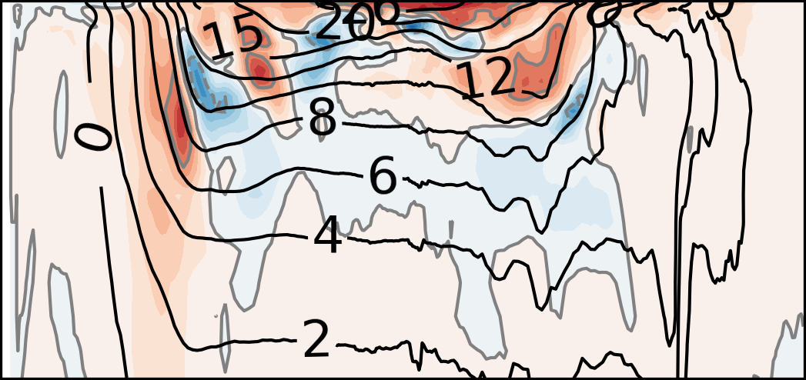
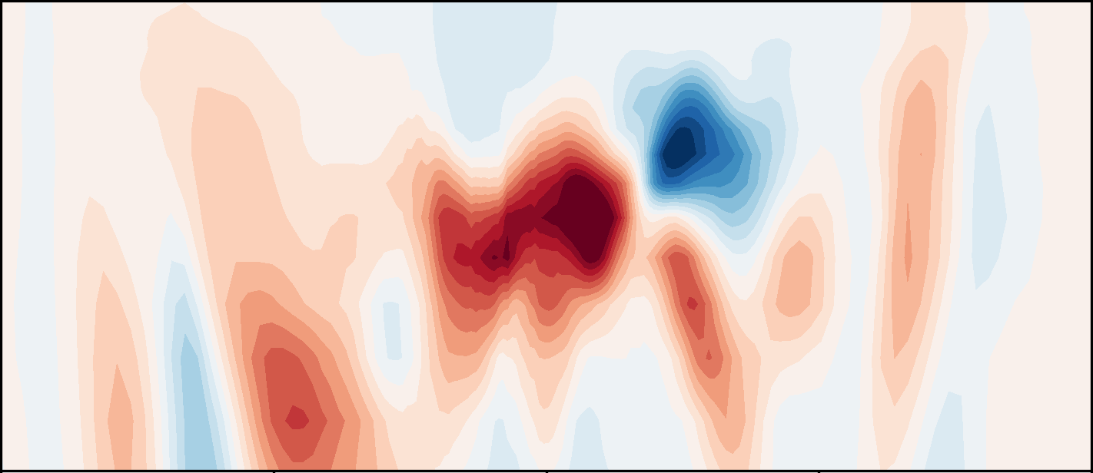

Slide 13
